Slide 1
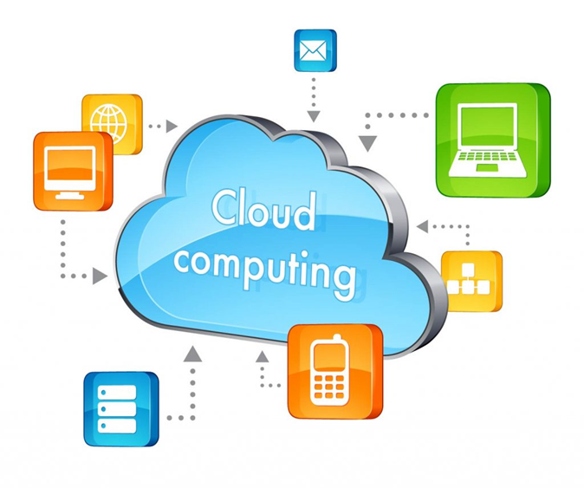


A Brief Power Point Presentation on
Submitted by : Pragyan ,Sheetal, Shruti, Gaurav & Abhishikt
Submitted to : Mr.Soumya Bhowmik

Slide 2
INTRODUCTION TO CLOUD COMPUTING
Cloud Computing Provides us a means by which we can access the applications as utilities, over the Internet. It allows us to create, configure and customize applications online.
With Cloud Computing users can access database resource via the internet from anywhere for as long as they need without worrying about any maintenance or management of actual resources.

Slide 3
What is cloud ?
The term Cloud refers to a Network or Internet.
In other Words, we can say that Cloud is something, which is present at remote location.
Applications such as e-mail, web conferencing, customer relationship management (CRM), all run in cloud.

Slide 4
What is Cloud Computing ?
Cloud Computing refers to manipulating, configuring and accessing the applications online.
It offers online data storage, infrastructure and application.
Cloud computing is both a combination of software and hardware based computing resources delivered as a network service.

Slide 5
Use Case of Cloud computing
Email : It is a technology that has been around for quite some time. Accessed via the internet, common clients ( like Microsoft's Outlook) are ingrained in core business processes. Whether its marketing, sales or, IT, email has a use case in every line of business, and its accessibility via the cloud is crucial.
More recently, Instant messaging apps like Microsoft Teams and Slack have begun taking the place of Email.

Slide 6
What is Apache Hadoop?
Open source software framework designed for storage and processing of large scale data on clusters of commodity hardware
Created by Doug Cutting and Mike Carafella in 2005.
Cutting named the program after his son’s toy elephant.

Slide 7
Uses for Hadoop
Scalability
Data-intensive text processing
Assembly of large genomes
Machine learning and data mining
Large scale social network analysis

Slide 8
Use case of Hadoop
Financial services companies use analytics to assess risk, build investment models, and create trading algorithms; Hadoop has been used to help build and run those applications.
Retailers use it to help analyze structured and unstructured data to better understand and serve their customers.

Slide 9
















Who Uses Hadoop?

Slide 10


